Slide 1
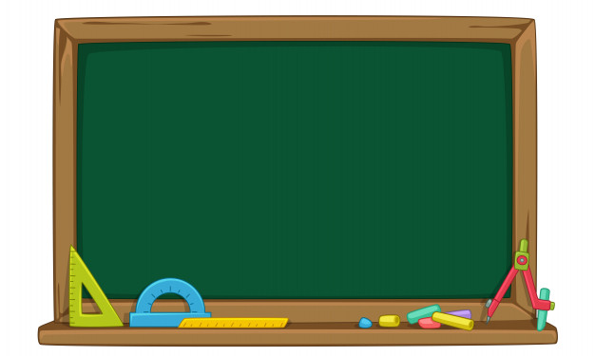
La Tabla del dos
Martes, 6/10/2020
1.- La tabla del dos aumenta de dos en dos.
2.- Gráfica la tabla de multiplicar del dos , relacionando con la adición o suma.
2 X 1 = 2
1+ 1 = 2
2 X 2 = 4
2 + 2 = 4

Slide 2
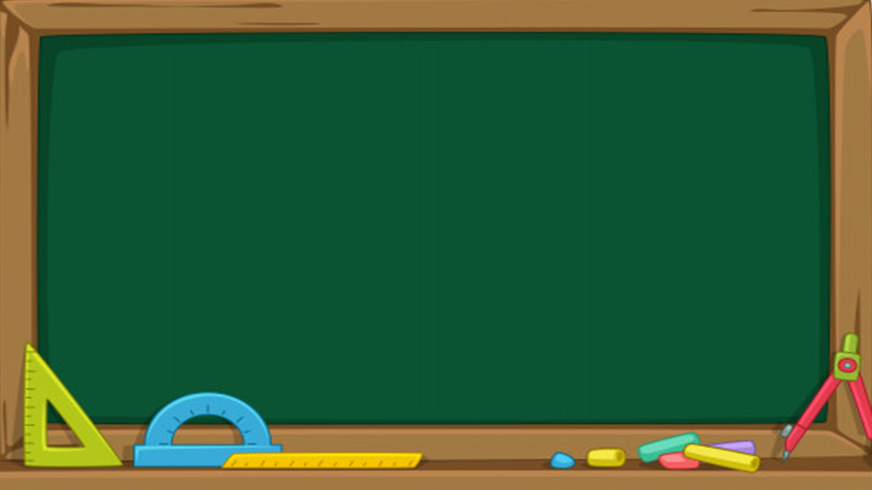
2 X 3 = 6
2 + 2 + 2 = 4
2 X 4 = 8
2 + 2 + 2 + 2 = 8
2 X 5 = 10
2 + 2 + 2 + 2 + 2 = 10

Slide 3
2 X 6 = 12
2 + 2 + 2 + 2 + 2 + 2 = 12
2 X 7 = 14
2 + 2 + 2 + 2 + 2 + 2 + 2 = 14
2 X 8 = 16
2 + 2 + 2 + 2 + 2 + 2 + 2 + 2 = 16

Slide 4
2 X 9 = 18
2 + 2 + 2 + 2 + 2 + 2 + 2 + 2 + 2 = 18
2 X 10 = 20
2 + 2 + 2 + 2 + 2 + 2 + 2 + 2 + 2 + 2 = 20

Slide 5
3.- Escribe la tabla de multiplicar y relaciona con la propiedad conmutativa
2 | X | 0 | = 0 |  |  | 0 | X | 2 | = 0
2 | X | 1 | = 2 |  |  | 1 | X | 2 | = 2
2 | X | 2 | = 4 |  |  | 2 | X | 2 | = 4
2 | X | 3 | = 6 |  |  | 3 | X | 2 | = 6
2 | X | 4 | = 8 |  |  | 4 | X | 2 | = 8
2 | X | 5 | = 10 |  |  | 5 | X | 2 | = 10
2 | X | 6 | = 12 |  |  | 6 | X | 2 | = 12
2 | X | 7 | = 14 |  |  | 7 | X | 2 | = 14
2 | X | 8 | = 16 |  |  | 8 | X | 2 | = 16
2 | X | 9 | = 18 |  |  | 9 | X | 2 | = 18
2 | X | 10 | = 20 |  |  | 10 | X | 2 | = 20

Slide 6
4.- Resuelve las siguientes restas.
4
X
2
8
X
2
5
X
2
2
X
2
9
X
2
3
X
2
1
X
2
7
X
2
6
X
2
2
X
2

